Slide 1
Moss-experiments in 2020
Samuli Launiainen 18.12.2019
1D model
Imaging moss structure and function (AtMath)
Laboratory measurements with Picarro (12/13C)

Slide 2
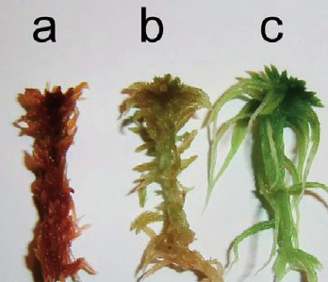
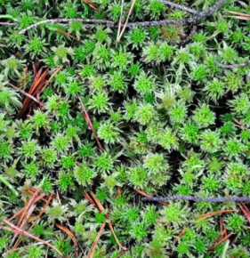
Goals!
Gustaf Granath
Luopioisten kasvisto
Mechanistically understand how moss community carbon- and energy balance depend on:
Moss traits (functional properties):
Structure, hydraulic, thermal, optical, photosynthetical, stress tolerance etc.
Environmental conditions:
Light, water, temperature, CO2, wind, …
How community-scale responses are formed?
local microclimate & local process rates → community-scale responses
E.g. heat stress, desiccation
To ’test’ literature hypotheses on the role of moss traits and resource allocation on:
Desiccation avoidance vs. tolerance
Heat stress, resource allocation
Competition among species: habitats vs. traits
To obtain a single–layer representation of mosses for ESM’s

Slide 3
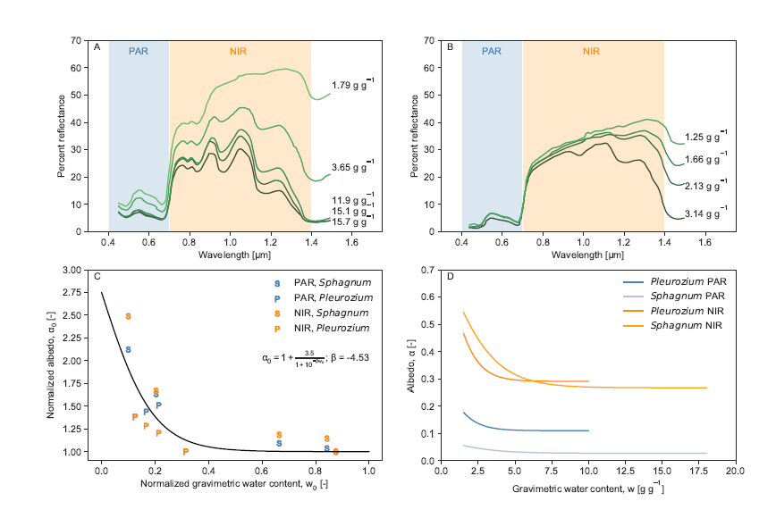
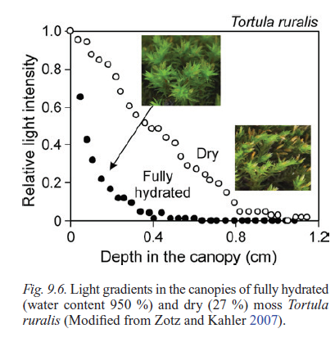
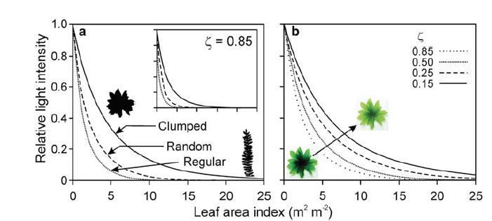
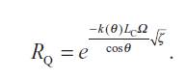
Moss reflectivity & light environment
Drying changes
Structure: community optical thickness
Pigments, color: ’leaf’ optical properties
Change in structure & light absorption affects:
Light, flow velocity, temperature profiles in moss
Evaporation, heat flux, photosynthesis etc.
A-J Kieloaho 2019; Niinemets & Tobias, 2014

Slide 4
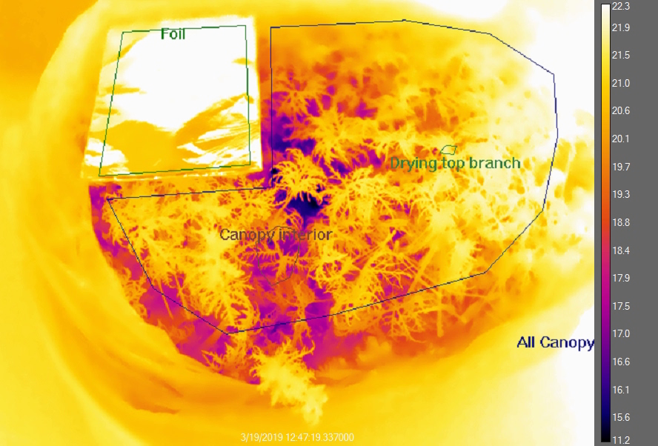
Desktop drying by thermal camera
Pavel Alekseychik 2019

Slide 5
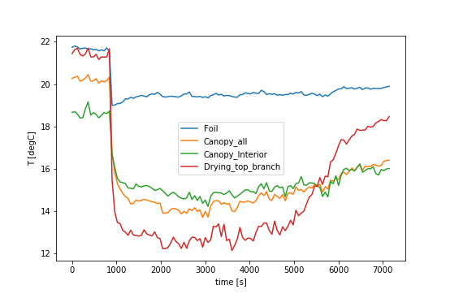
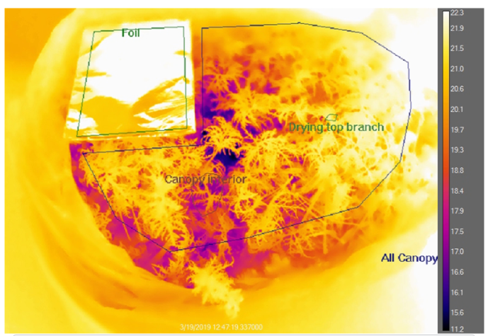
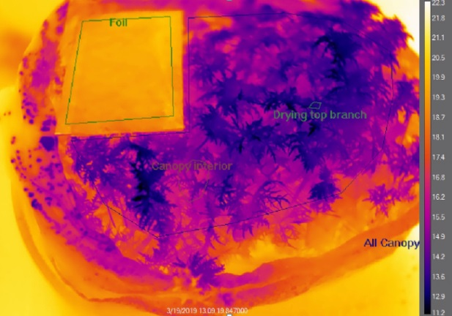
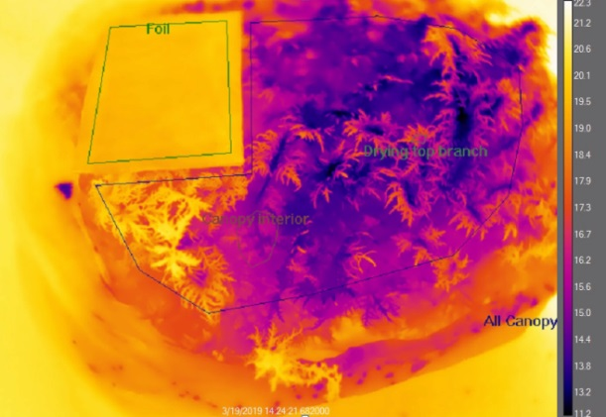
Desktop drying by thermal camera
Note temperature gradient in dry vs. wet moss
Radiation balance
Evaporative cooling
Progressive drying from top
Pavel Alekseychik 2019

Slide 6
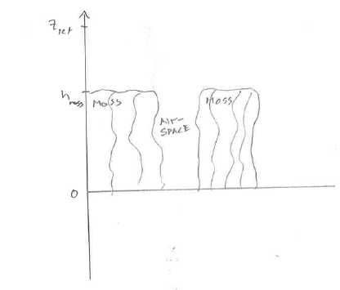
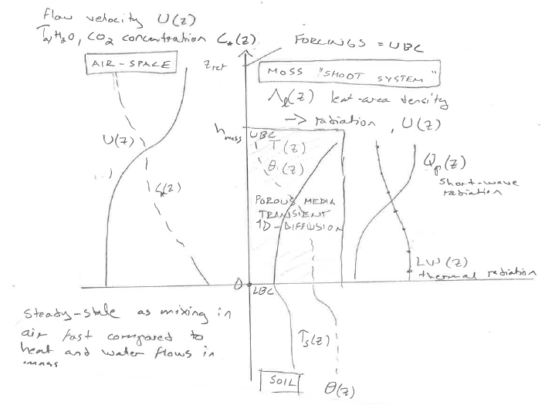
Moss canopy as 1D porous media (’sponge’)
Two domains, both horizontally homogeneous porous media
Moss ’tissues’: ds/dt = …
Liquid water flow and heat conduction, analogy to 1D diffusion in soil
Coupled equations
Moss ’air space’: ds/dt = 0
Shortwave and and thermal radiation in porous media
Momentum, water vapor and heat transfer in (diffusion analogy)
Domains coupled trough surface energy balance at each ’canopy layer’
Moss properties determine characteristics.

Slide 7
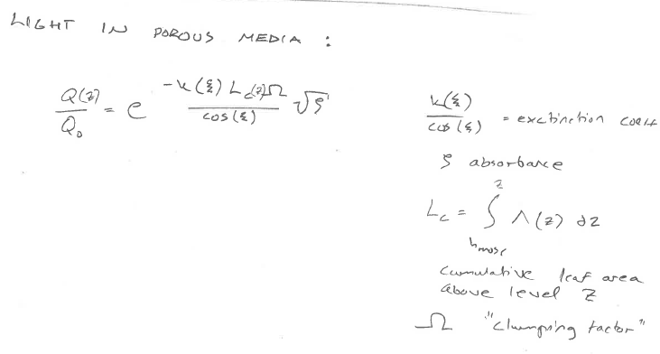
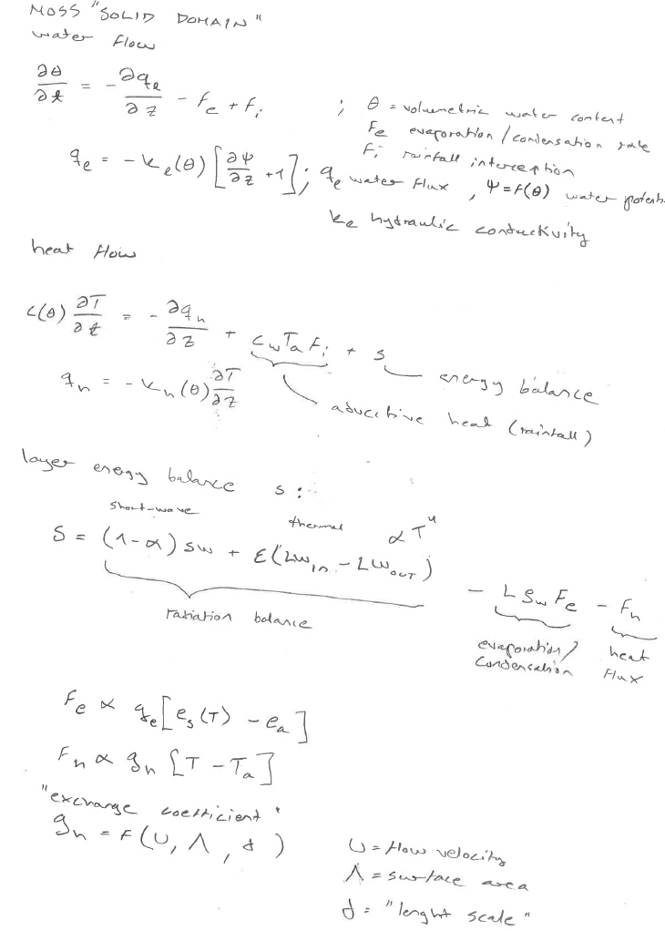
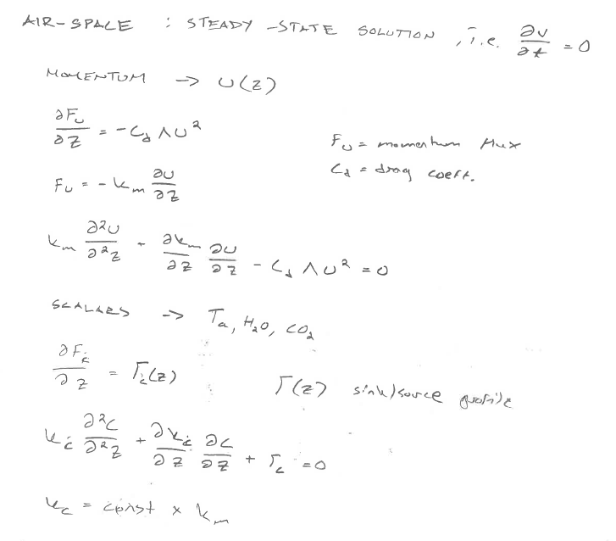
Leaf-area density
’traits’

Slide 8
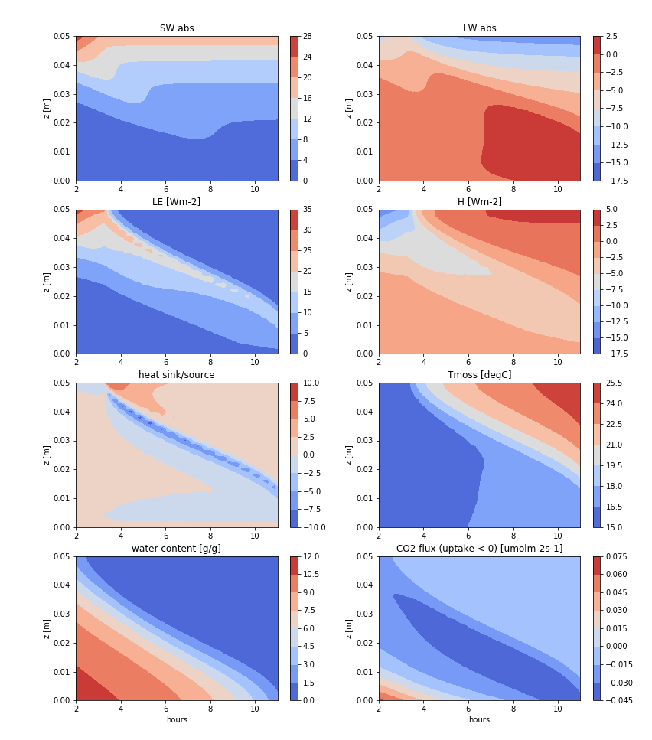
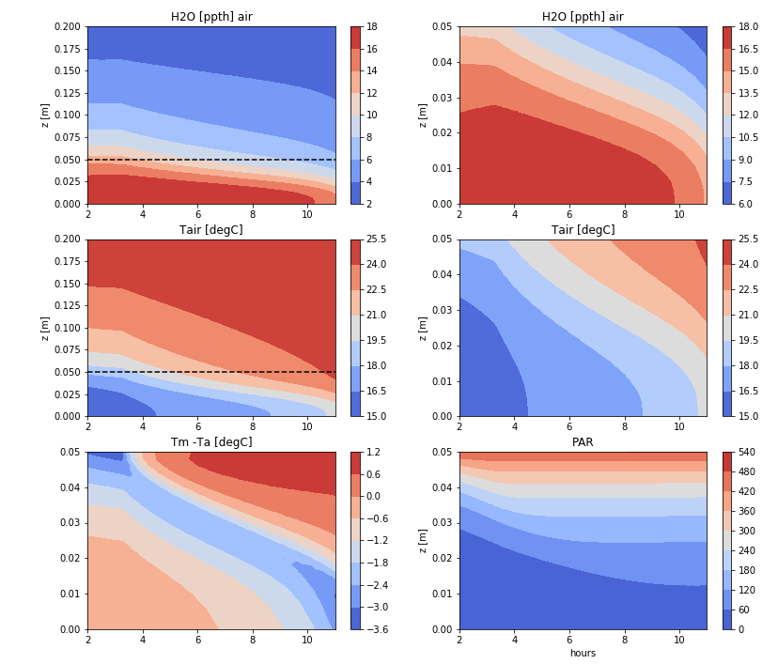
Feather moss, rapid drying: Light 200 Wm-2, Ta 25degC, RH 10%, flow 0.3 m/s
0.05m canopy, 10 layers. Lower boundary zero heat and water flux
Moss surface area set to decay linearly when water content below 5 g/g; goes to half at 0 g/g
Photosynthesis & respiration = f(water content & T)

Slide 9
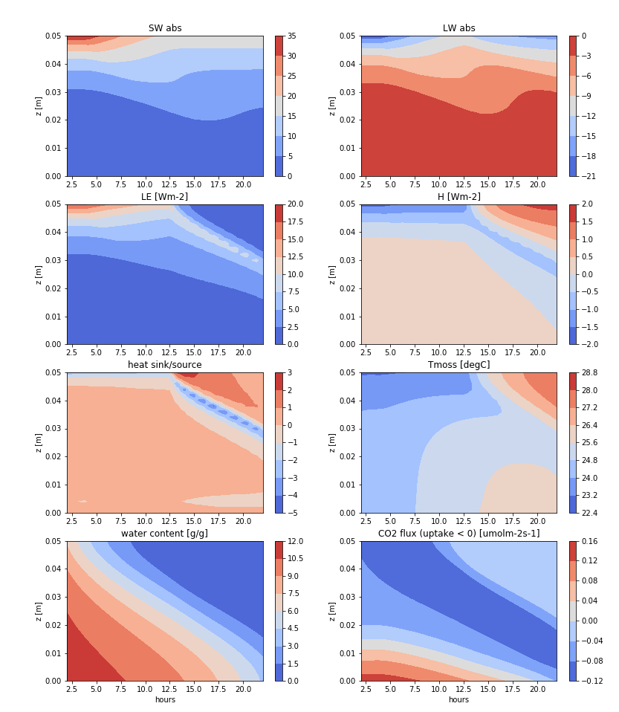
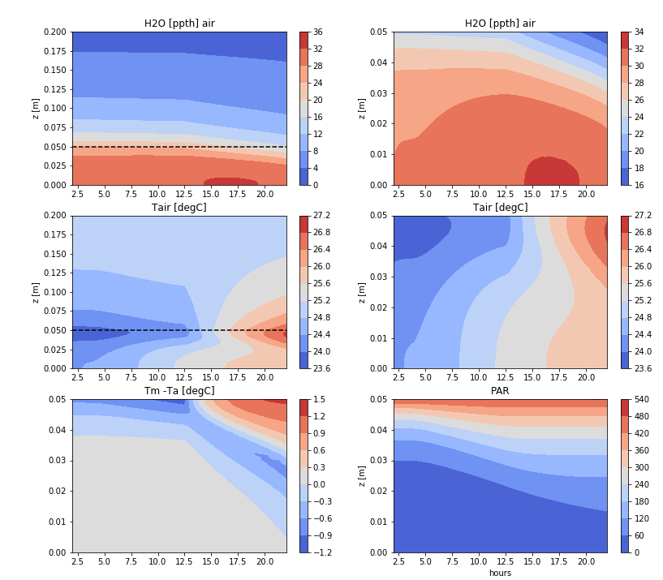
Feather moss, slow drying: Light 200 Wm-2, Ta 25degC, RH 10%, flow 0.05 m/s
Lower boundary zero heat and water flux
Moss surface area decays linearly when water content below 5 g/g to half at 0 g/g
Photosynthesis & respiration = f(water content & T)
Note time span 20 h

Slide 10
Traits by moss imaging?
Community structure and how it changes when moss dries?
Leaf-area index (LAI, m2 ’leaf’ m-2 ground); moss surface area projected to horizontal plane
Vertical profile of leaf-area
Fractals?
Canopy smoothness / roughness?
3D Lidar: https://leica-geosystems.com/fi-fi/products/laser-scanners/scanners/leica-scanstation-p40--p30
Thermal imaging: Flir xx
RGB → color change?
Moisture gradients?
Internal vs. external water?
Hydraulic conductivity: dye as tracer?
Controlled experiment(s) in growth chamber:
light, RH, T, flow
Lidar & thermal timeseries

Slide 11
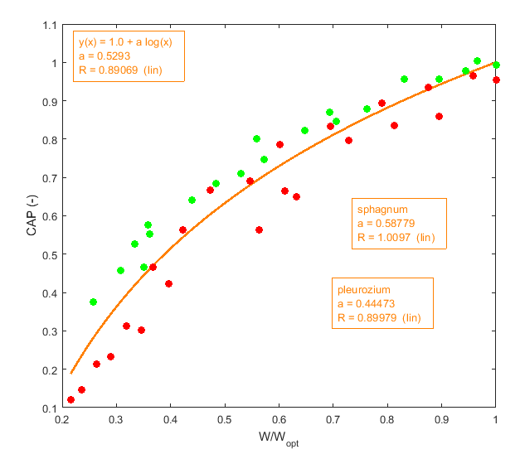
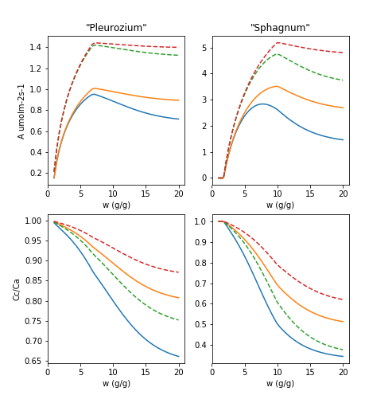
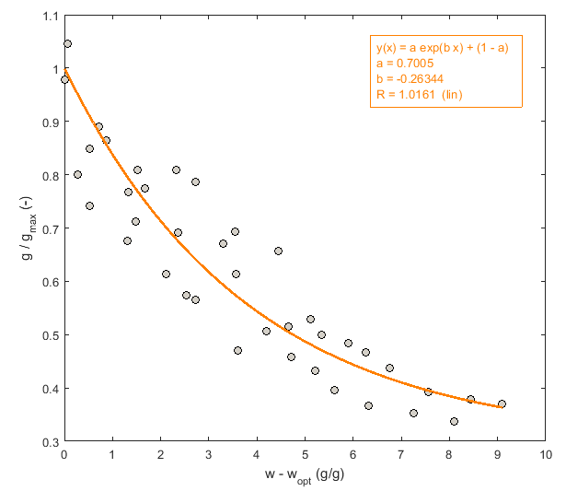
Dry end: down-regulation of machinery
Farquhar-model: desiccation affects Vcmax, Jmax, Rd
Air-chloroplast diffusion decreases with water content
Community scale tests (constant T); optima and shape of moisture response at wet end determined by Vcmax vs. supply
800 ppm
hi g
400 ppm
low g
Wet end: increasing diffusion resistance
Data: Williams and Flanagan 1998

Slide 12
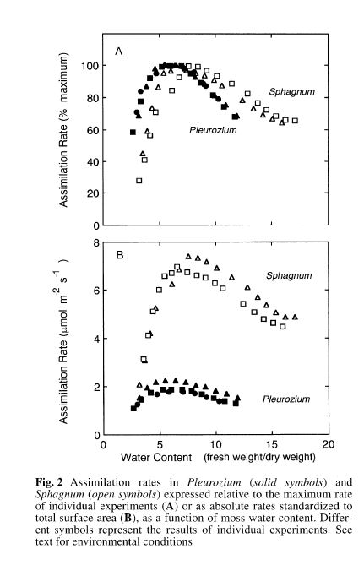
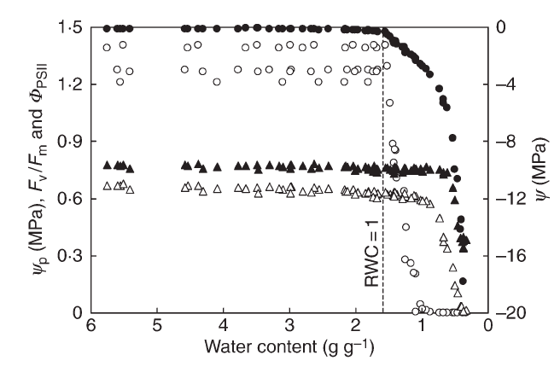
… response depends on scale: community vs. shoot
Hajek & Becket, 2008: Single shoot
How community-level responses form?
Williams & Flanagan, 1996: Community scale

Slide 13
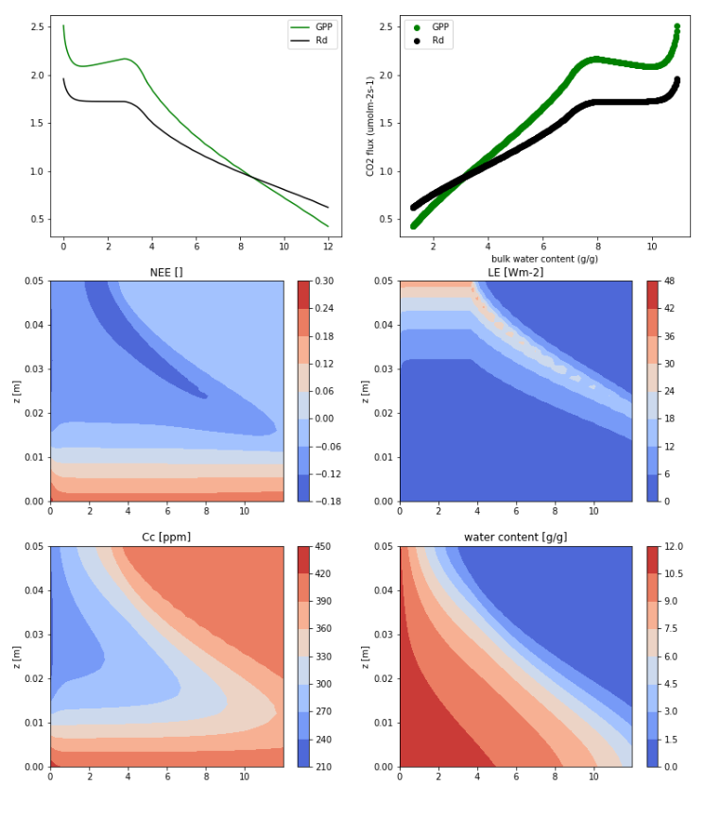
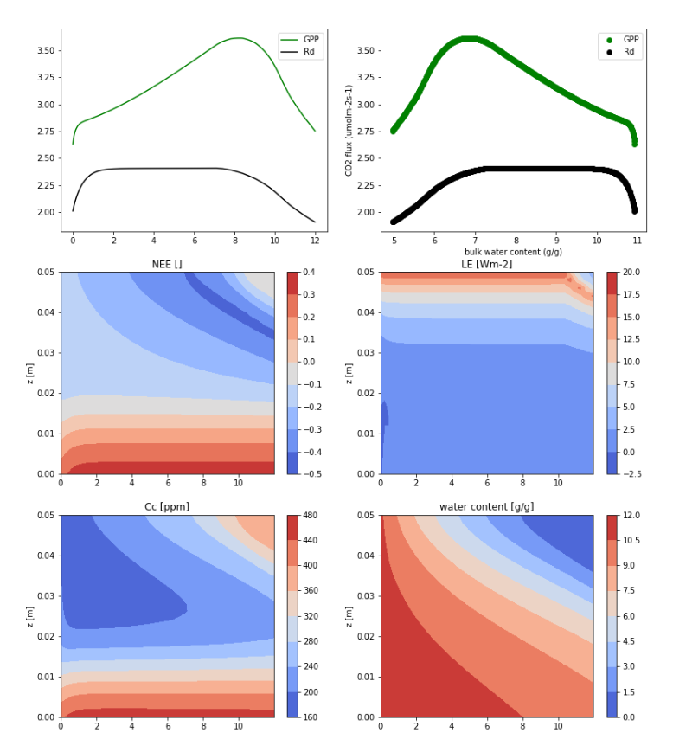
Carbon balance and bulk moisture response curves: non-shrinking moss (light regime time-invariant and same for both cases).
Non-linear decay of Vcmax, Jmax and Rd when water content < 2 g/g.
Ignore curvature at wet end (due to initial conditions)
fast drying (U=0.3m/s)
slow drying (U=0.05m/s)

Slide 14
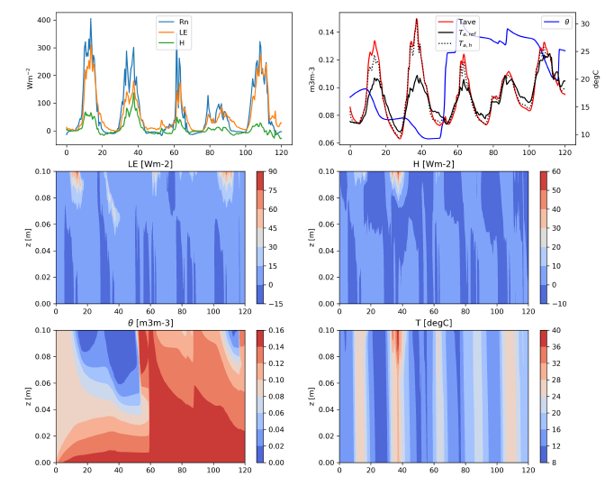
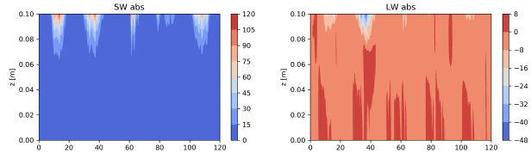
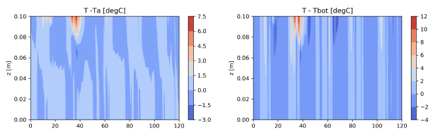
Dynamic case on open habitat, non-shrinking moss, capillary water flow at lower boundary, zero flux for heat.
Evaporation / heat flux
Water content / moss tissue temperature
- precipitation events
Short-wave / thermal radiation
Moss-air dT / moss top-bottom dT

Slide 15
Moss-experiments: three main questions
Moisture and temperature -responses of photosynthesis and respiration
Canopy / community scale
Shoot / canopy layer scale
Q1: How air-cloroplast CO2 conductance should be described in models?
Q2: Quantify temperature –responses of photosynthesis at optimum moisture content
Recovery from drought-dormancy
Rate of recovery: how rapidly photosynthetic capacity recovers
Recovery-associated respiration peak
Re-wetting: swelling and opening of leaves
Q3: How hysteresis and additional metabolic costs related to re-wetting should be modeled?
Vertical light, temperature and moisture gradients in moss canopies: profiles of CO2 uptake and evaporation
To validate multi-layer moss model
Q3: How canopy-scale fluxes form and how this is related moss traits?

Slide 16
CO2-exchange
Mechanistic C-balance model with different parameters should work for both types → Farquhar –model tailored for bryophytes (Willliams & Flanagan, 1998; Porada et al. 2016; etc.
Key uncertainties:
air – chloroplast CO2 conductance → 13C / 12C isotope fluxes
capacity and rate of desiccation recovery: hysteresis in Amax, Rd → chamber fluxes, isotopes
Respiration as function of photosynthetic capacity and env. conditions
Vertical variations in light, temperature and moisture in moss canopy: scale issues; which layers contribute to Rd and A at which ’bulk water content’ → RTG-tomography + thermal imaging

Slide 17
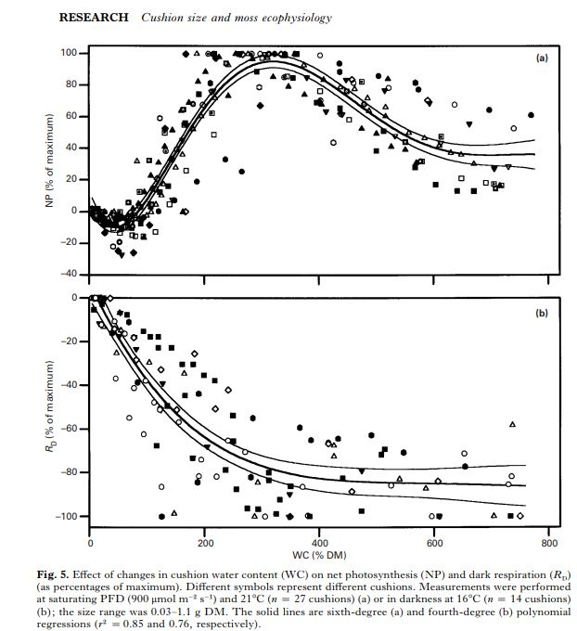
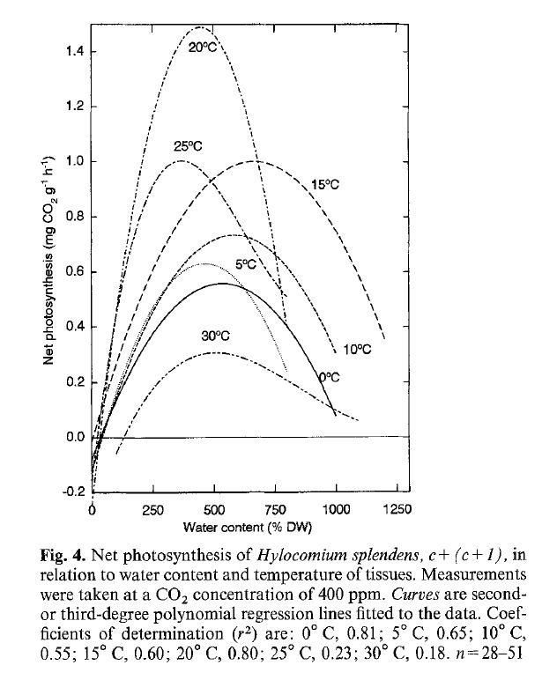
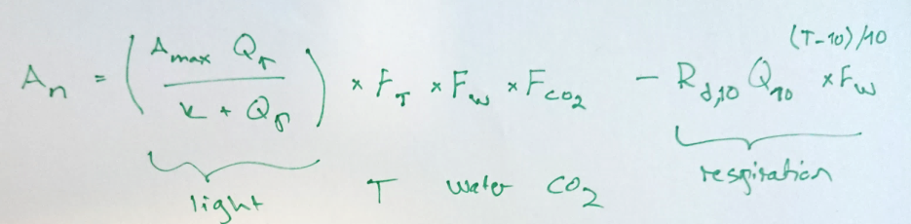
Moss photosynthesis & net C balance at community scale
An = f(light, T, W, CO2, {state}, {traits})
State of the art:
Community scale, empirical,
no CO2 effects, no history, responses
uncertain

Slide 18
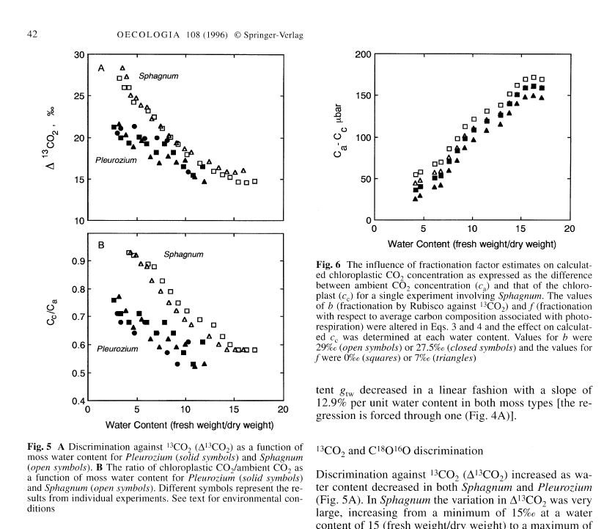
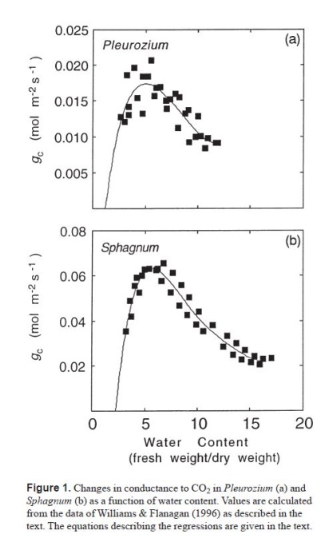
13C / 12 C Isotope-fluxes during drying-wetting cycles
At dry end: capacity limitations (desication, turgor loss) → high discrimination → high delta 13C
At wet end: CO2 diffusion limitations → CO2 starvation → low discrimination → low delta 13C
We get Cc/Ca as a function of water content W
Flux F = g (Ca – Cc) = g(1 – Cc/Ca) → g = F / (1 – Cc/Ca) as f(W)
Constant env. conditions (sat. light, T, RH, CO2) during single experiment
Replicates, species (N=?)
Vary CO2 levels → get A-W-CO2 –response space
Respiration rate as f(W)
Desiccation recovery

Slide 19
Lab setup?
Large chamber, mosses in ’basket’
Picarro : 13/12 C, Anet, F_h2o, F_ch4 + microclimate (T, RH)
Microclimate: Picarro (T, RH), Par. Flow rate → ’flow velocity’ for interpreting F_h2o
Water content: initial weight - sum(F_h2o). And/or electric scale?
Moss canopy T (and gradient)? Pt100 or thermistor array?
Thermal imaging (Pavel?); chamber transparency?
At minimum: drying – wetting cycles + light/dark
Data logging? Flux calculation?
Sample preparing; fumigation?
2nd Picarro (Tiia) week 3 / 4
Schedule for test measurements and later larger experiment?

Slide 20
